Slide 1


HELIOS INTERNATIONAL SDN BHD(1425451-D)
Company profile

Slide 2
About us
Helios International Sdn Bhd is an Malaysia based Manufacturing company established in May 2020 which is engaged in the manufacturing and exporting of various SMS and Non Woven products.
Our utmost priority is to connect quality products to your caring hands and also first-class customer service.
HELIOS INTERNATIONAL SDN BHD. Now we are standing out with 4 high speed manufacturing line which operates 24/7 and generates 2mil SMS and Non woven products such Surgical gown, Isolation gown, Shoe Cover, Buffon Cap, Surgical Drape, Medium Drape, Bedsheet Cover, Pillow Case.
Helios deals with production and trading of all kind hospital disposable products. which has its roots in the healthcare, F&B and semiconductor industry. Helios has earned its reputation all over the South east Asia and is also catering European Japanese and Middle East market with supplying of safety products.
Our success lies in combining these traits without compromising one of them by using high tech materials and innovative designs. This approach resulted in our products being used in 18 countries divided over 4 continent.
“ Our company’s goal is to provide protection to every induvial who is working as 1st line to save community life”
2020
-HRS establishment with one production line for isolation Gown
-Extended 2 new production line for boot cover and hoot cover
2021
2022
2023
- Expanding our business to South Africa and Middle East
- Stablish Helios Sdn Bhd.
- Automated existing production line of gown, show cover and hoot cover. - MDA and CE certified
- Stepping in to overseas market Dubai, Philippines, Indonesia, Taiwan and India.
- Sterile Surgical Gown Manufacturing

Slide 3


Our BOARD OF DIRECTORS
Harrish Harley Davidson (Founder & CEO)
(MBA in International business)
Harrish comes with the vast experience of 25 years in sales and Business development. He has worked with several multinational companies across different geography.
Namita Kelwa (Co Founder & Managing Director)
(Master in Regulatory affair (honours) & Bachelor in Pharmacy”)
A highly skilled individual who is having a experience of a decade into both manufacturing and sales. She come with an experience of Quality assurance, Regulatory Affair and International marketing and sales.

Slide 4
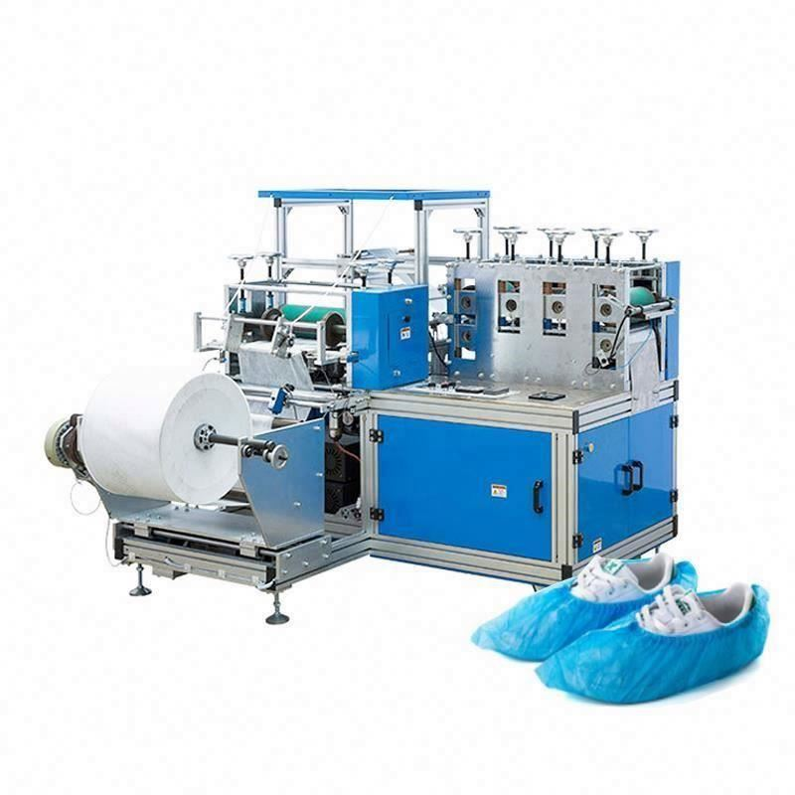
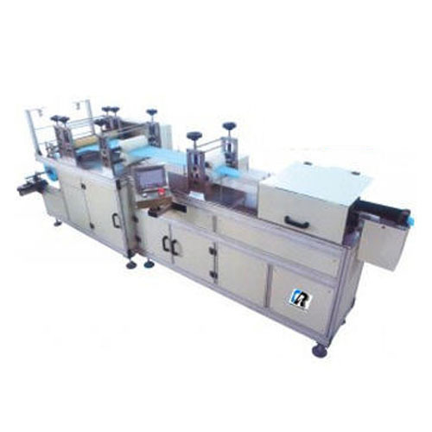
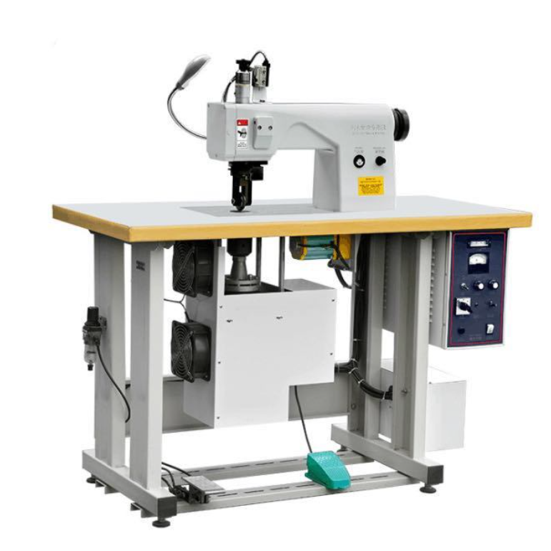
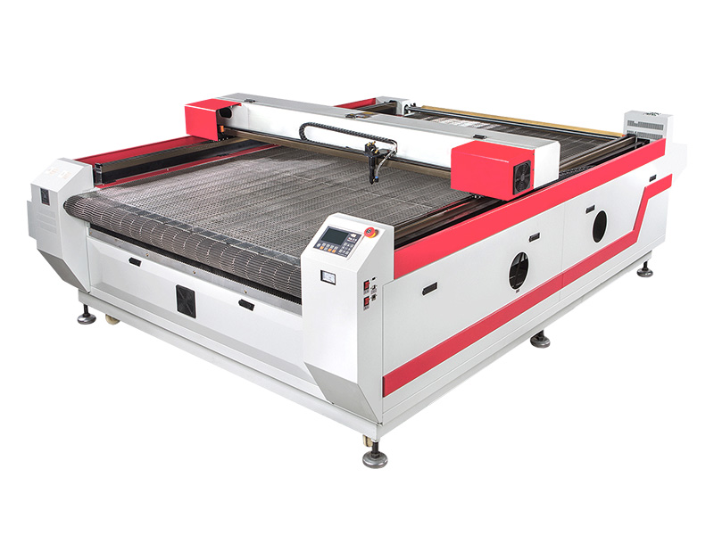
Our Machines
Non Woven Shoe Cover Machine
Bouffant Cap Machine
Laser cutting Machine for Isolation Gown
Ultrasonic Surgical Gown swelling Machine

Slide 5
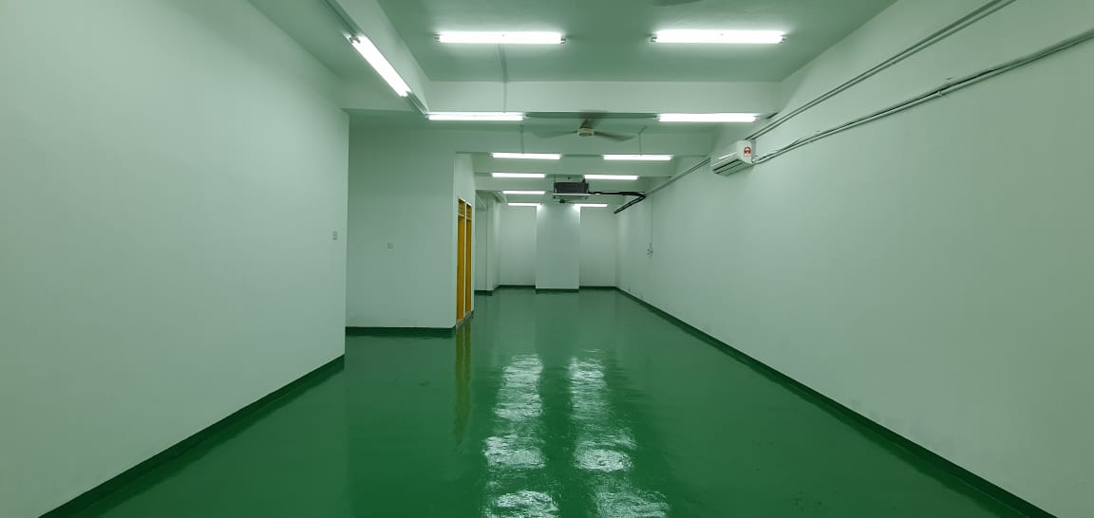
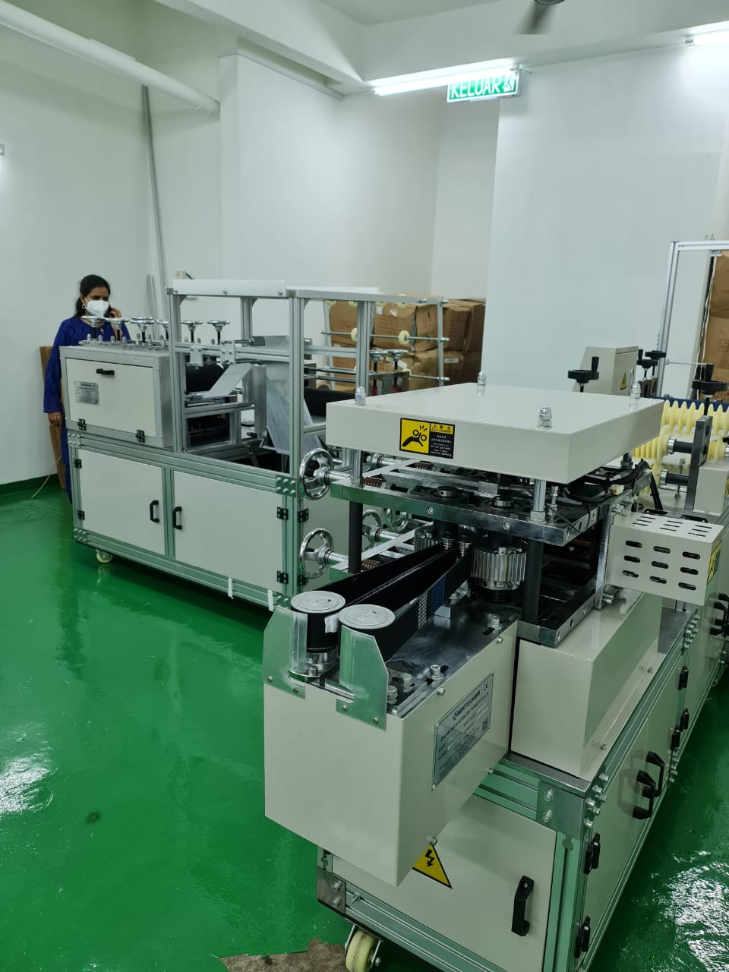
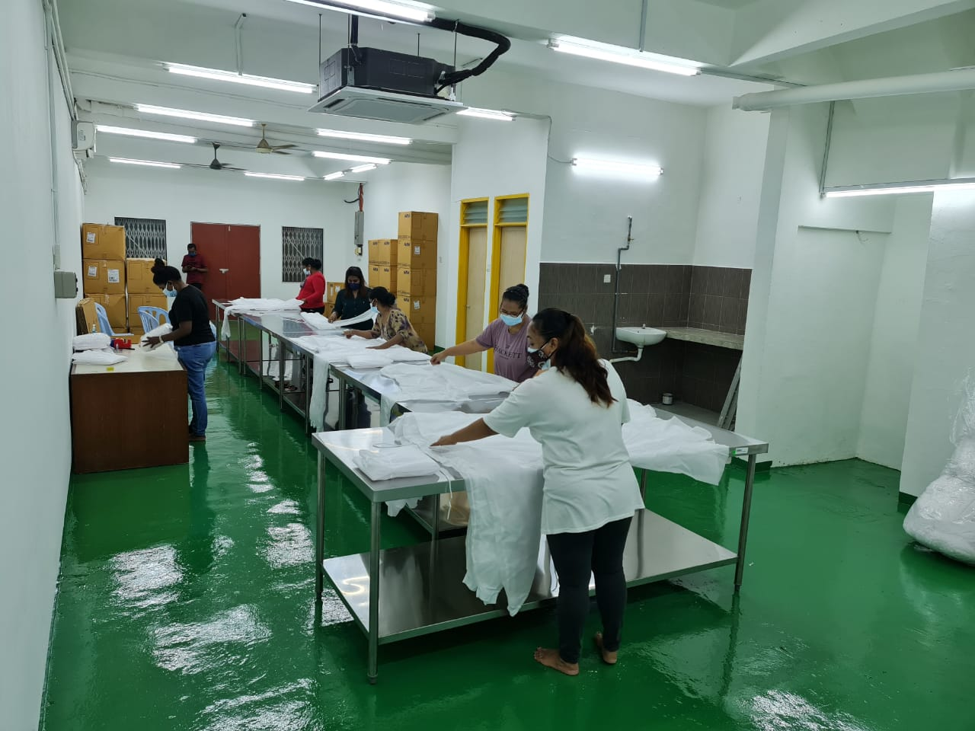
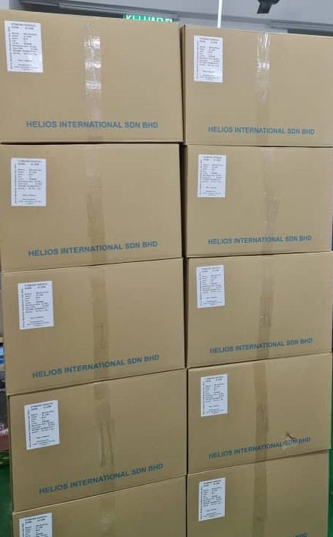
Our Facility
Cleanroom Area
Production Area
Packaging Area
Storage Area

Slide 6
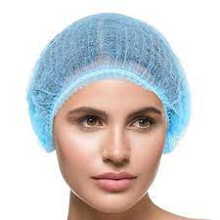
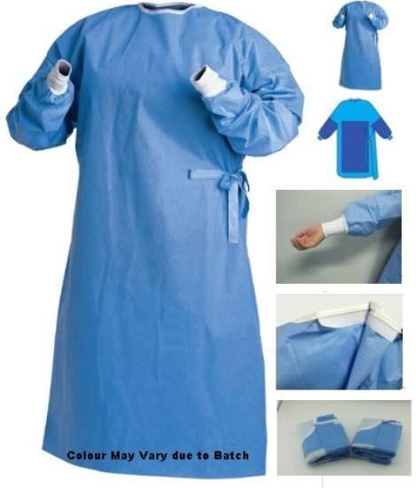

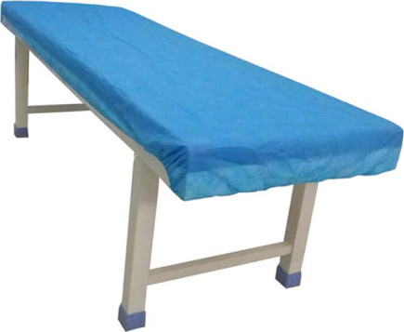
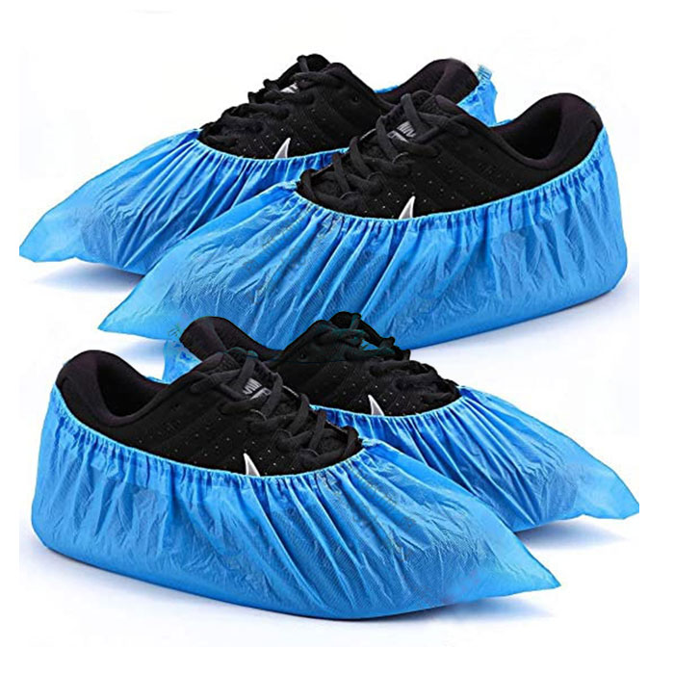
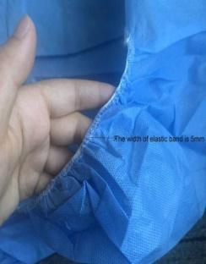

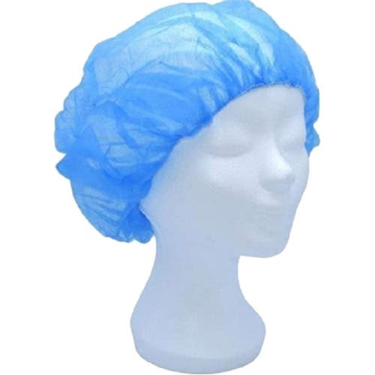
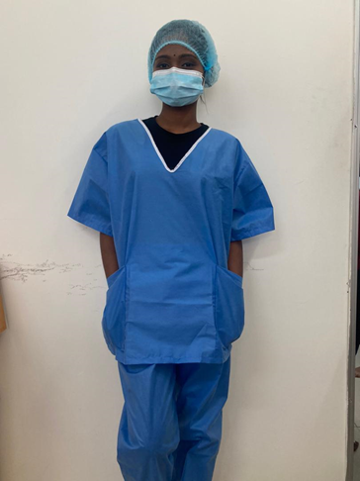
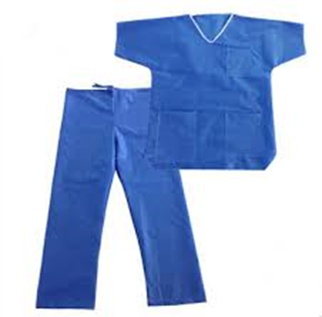
Product Range
BOUFFANT CAP
MATERIAL :NON WOVEN POLYPROPYLENE (PPE)
WEIGHT: 12-15 GSM
OTHER SPECIFICATION:SINGLE PLY & HIGH ELASTIC
EDGE.
SIZE: UNIVERSAL (16 CM LENGTH)
COLOUR: BLUE & WHITE
100 PCS/BAG , 20 BAGS/CARTON
CHEMO GOWN
SURGICAL GOWN
MATERIAL: SMS MATERIAL
WEIGHT: 45-50 GSM
COLOUR: BLUE
SIZE: M,L,XL.XXL
OTHER SPECIFICATION:WATER REPPELENT,COTTON KNITED CUFF, BELOW KNEE LENGTH,ANTI-STATIC & STERILE
MATERIAL: SMS MATERIAL
WEIGHT: 45-50 GSM
COLOUR: BLUE
SIZE: M,L,XL, XXL
OTHER SPECIFICATION:WATER REPPELENT,COTTON KNITED CUFF, BELOW KNEE LENGTH,ANTI-STATIC & STERILE
SHOE COVER
MATERIAL: NON WOVEN POLYPROPYLENE (PPE)
WEIGHT: 30 GSM
OTHER SPECIFICATION:ELASTIC CLOSURE
& WATER RESISTANCE
SIZE: UNIVERSAL (15CM X 40CM)
COLOUR: BLUE & WHITE
100 PCS/BAG , 20 BAGS/CARTON
SURGEON CAP
BED SHEET COVER
MATERIAL: NON WOVEN POLYPROPYLENE (PPE)
WEIGHT: 40GSM
DESIGN: BERET
OTHER SPECIFICATION: TIE ON FIT
& WATER RESISTANCE
SIZE: 19CM(TOP SIDE) 10CM(HEIGHT)
COLOUR:BLUE
MATERIAL: NON WOVEN POLYPROPYLENE (PPE)
WEIGHT: 30 GSM
OTHER SPECIFICATION:ELASTIC CLOSURE & WATER RESISTANCE
SIZE: UNIVERSAL & BASED ON REQUIREMENT
COLOUR:BLUE
PILLOW CASE
DISPOSABLE SCRUB SUIT
MATERIAL: NON WOVEN POLYPROPYLENE (PPE)
WEIGHT: 30 GSM
OTHER SPECIFICATION:ELASTIC CLOSURE & WATER RESISTANCE
SIZE: UNIVERSAL & BASED ON REQUIREMENT
COLOUR:BLUE
Nurse CAP
MATERIAL: NON WOVEN POLYPROPYLENE Fabric
WEIGHT: 30GSM
OTHER SPECIFICATION: TIE ON FIT
& WATER RESISTANCE
SIZE: 21””
COLOUR:BLUE
MATERIAL: SMS 45GSM
COLOUR: BLUE
OTHER SPECIFICATION: ANTI-STATIC ,LINT FREE, FIRE RESISTANCE & WATER PROOF.

Slide 7
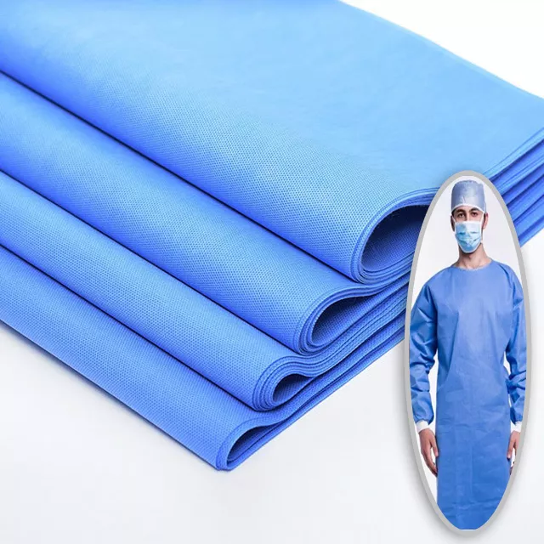
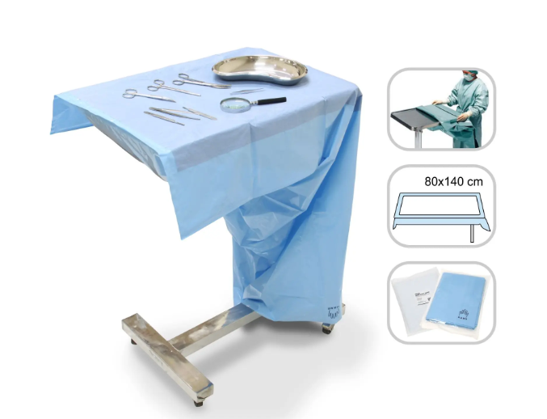
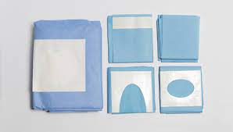
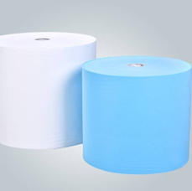
Product Range
Myo Table Cover
SMS MATERIAL
SURGICAL DRAPES
MATERIAL: SMS and Polyethylene
WEIGHT: 45-50 GSM
COLOUR: BLUE/GREEN
SIZE: 55’X30’
OTHER SPECIFICATION: MAYO TABLE COVER IS A STERILE DRAPE USED IN SURGICAL OPERATIONS. USED AS A SINGLE DRAPE TO COVER THE TABLE OF THE SURGERY TOOLS. MADE OF POLYETHYLENE WITH ABSORBED LAYER, PROVIDED WITH ABSORBENT LAYER
WEIGHT : 10GSM TO 65 GSM
FEATURE : SPUNBOND MELTBLOWN SPUNBOND, TRI LAMINATE NON WOVEN FABRIC, HIGH TENSILE STRENGTH, SOFTNESS, COMFORT, BREATHABILITY, WEARABILITY AND ANTISTATIC
WE PROVIDE MANY KIND OF DISPOSABLE SURGICAL DRAPES TO PREPARE AND MAINTAIN A STERILE FIELD IN THE OPERATING ROOM TO MINIMIZE THE RISK OF INFECTION.
SMS MATERIAL
FEATURE : BREATHABLE, ECO FRIENDLY, SHRINK-RESISTANT,
WEIGHT : 9GSM TO 55 GSM
TEAR RESISTANT, FIRE RETARDANR, HYDROPHILIC
SIZE : 3CM TO 320 CM
NIN WOVEN TECHNIC : SPUN BONDED
MATERIAL: 100% POLYPROPYLENE

Slide 8
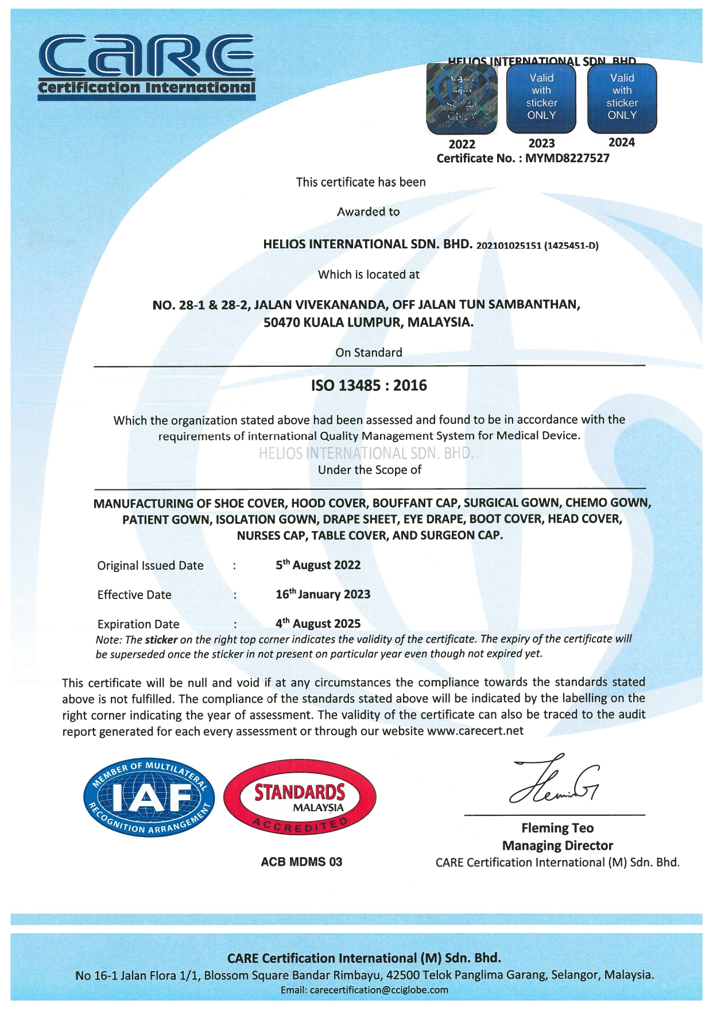
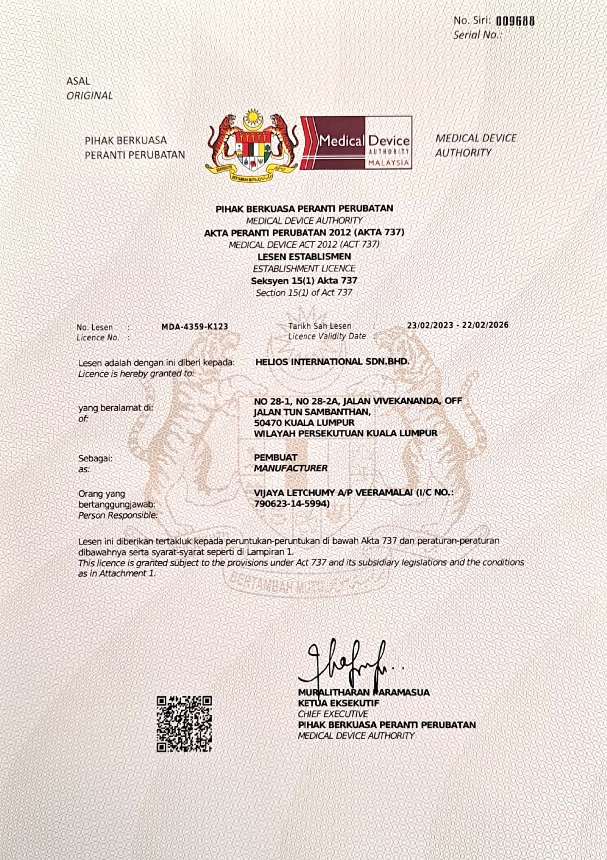
OUR CIRTIFICATEAS

Slide 9
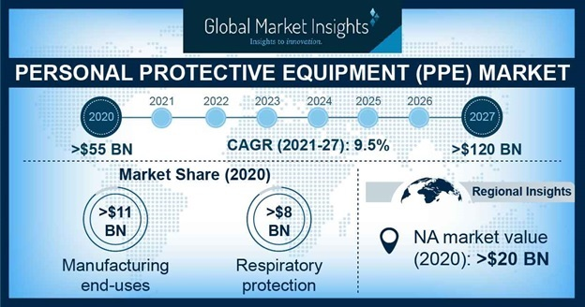
Market overview
Global personal protective equipment market size was over USD 55 billion in 2020 and is estimated to grow at 9.5% CAGR (compound Annual growth rate) between 2021 and 2027. Increasing consumer awareness regarding the importance of health and safety coupled with essential mandates at workplaces regarding wearing personal protective equipment (PPE) to avoid accidents and fatal incidences in commercial premises is likely to raise the market over the forecast period.
Increasing instances of accidents and injuries to workforce owing to the lack of precautions adopted for maintaining personal safety ad hygiene in manufacturing plants is expected to further raise awareness among workers and factory owners regarding the importance of equipping factory personnel with PPE. The high rate of occupational accidents at workplace is expected to open up new growth opportunities for personal protective equipment market during the forecasted timeframe.
being enforced by governments of different countries across the world to prevent further transmission of the coronavirus infection among public health workers such as the Families First Coronavirus Response Act should further foster the PPE market growth over the assessment period. The sudden occurrence and rapid rate of transmission of infectious diseases such as COVID-19 has compelled employers across the globe to exercise strict control over worker safety and security measures, in turn raising the demand for PPE and contributing to growth of the market. Moreover, stringent regulations
Source:- https://www.gminsights.com/industry-analysis/personal-protective-equipment-PPE-market

Slide 10
Our CURRENT production capacity
Target Market
Product | Production Capacity
Bedsheet Cover | 350,000/Month
Bouffant Cap | 1,000,000/Month
Shoe Cover | 1,000,000/Month
Surgical Gown | 30,0000/Month
Chemo Gown | 30,000/Month
Surgeon Cap | 700,000/Month
Malaysia 1st – our main focus is to cater Malaysia and Malaysian first by providing them best quality at better price and then moving into the other market like:-
APAC
Middle east
Australia
Europe
US

Slide 11
Thank you

